Slide 1



Online Retail Sales Forage_virtual_internship
View in Power BI
Last data refresh:
21/05/2023 07:08:05 UTC
Downloaded at:
21/05/2023 07:59:42 UTC

Slide 2
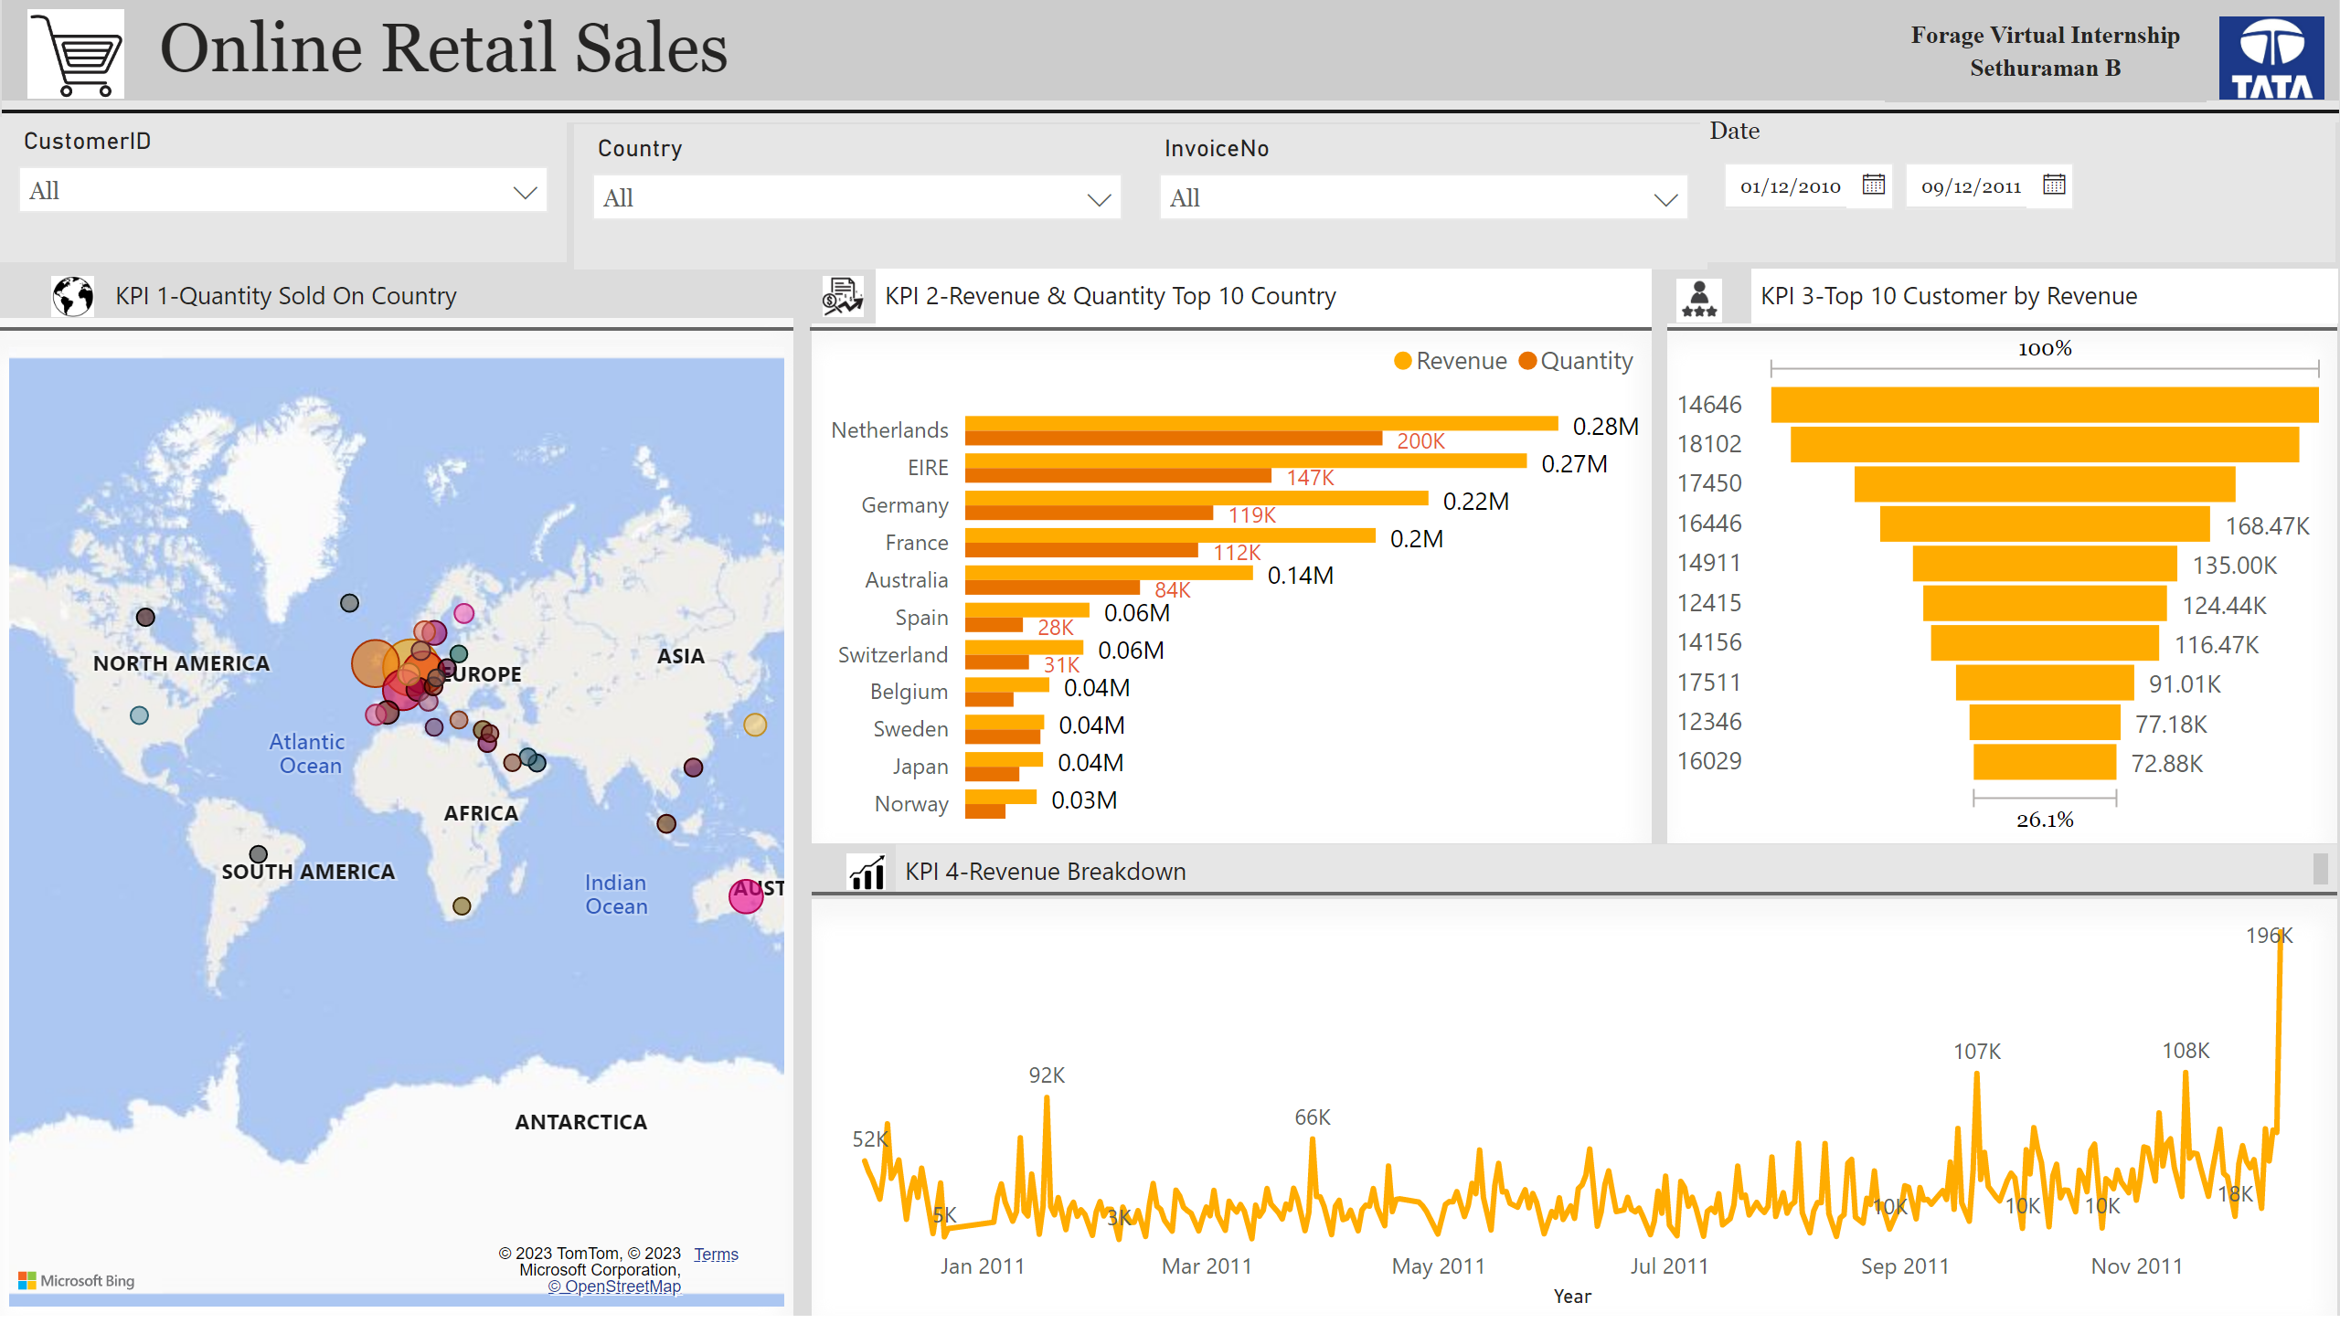
Online Retail
Notes:
image
No alt text provided
textbox
No alt text provided
shape
No alt text provided
Quantity Sold On Country
No alt text provided
Revenue & Quantity Sold by Country
No alt text provided
Top 10 Customer by Revenue
No alt text provided
Date
No alt text provided
slicer
No alt text provided
slicer
No alt text provided
slicer
No alt text provided
textbox
No alt text provided
textbox
No alt text provided
textbox
No alt text provided
textbox
No alt text provided
lineChart
No alt text provided
shape
No alt text provided
shape
No alt text provided
shape
No alt text provided
shape
No alt text provided
image
No alt text provided
image
No alt text provided
image
No alt text provided
image
No alt text provided
image
No alt text provided
textbox
No alt text provided

Slide 3
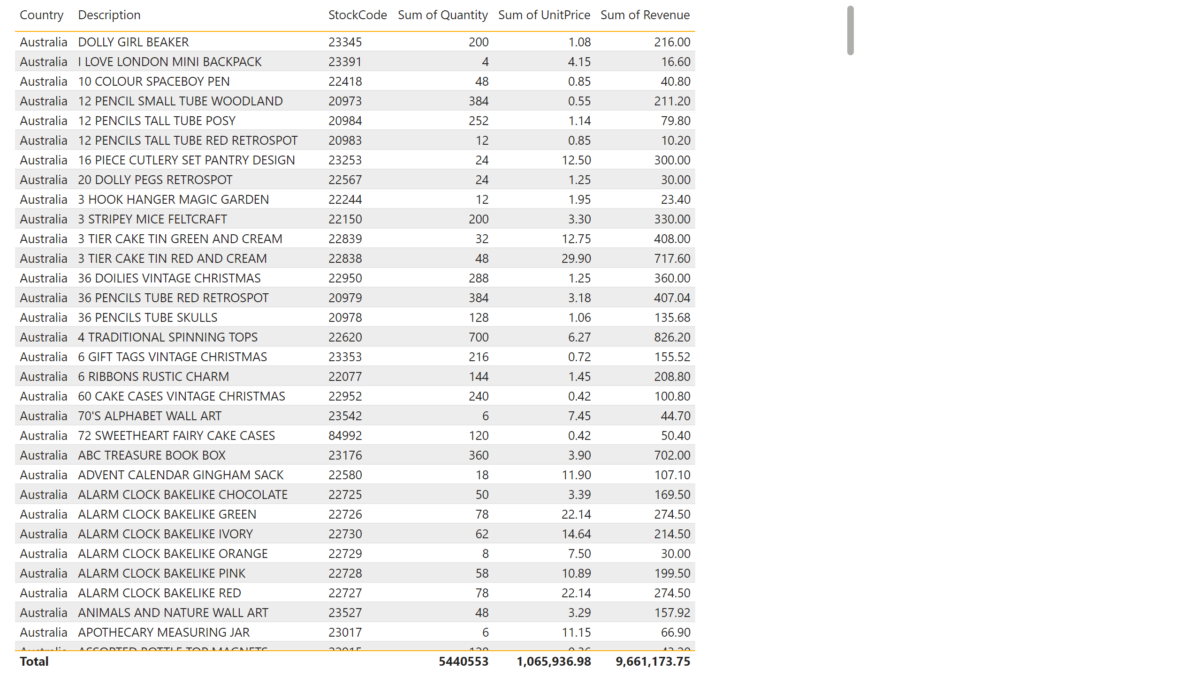
Detailed
Notes:
tableEx
No alt text provided

